Slide 1
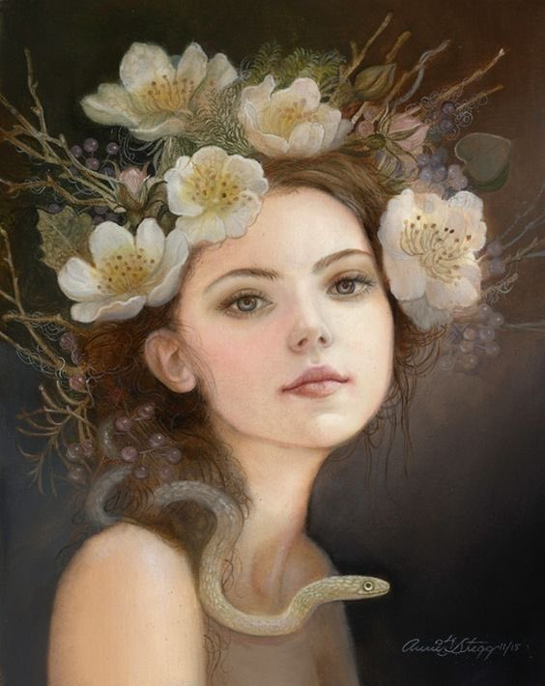
‘Macbeth’
English Literature
Paper 1
Revision 1:
Big Ideas

Slide 2
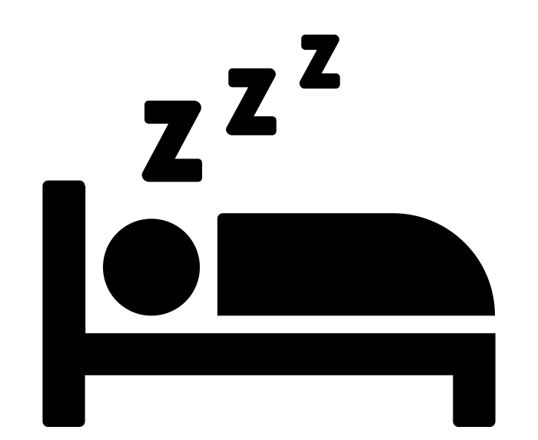
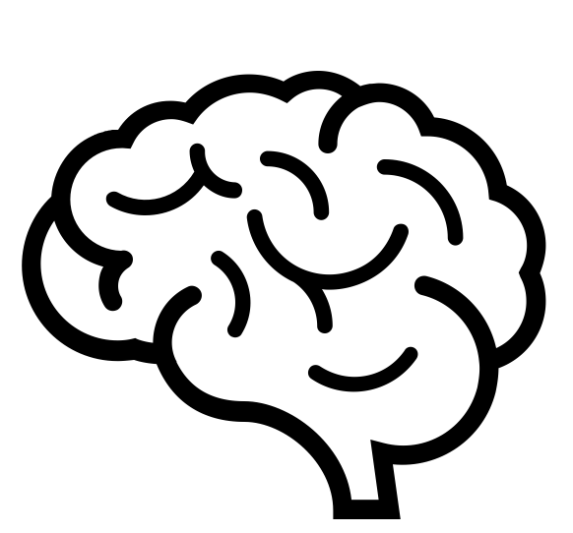
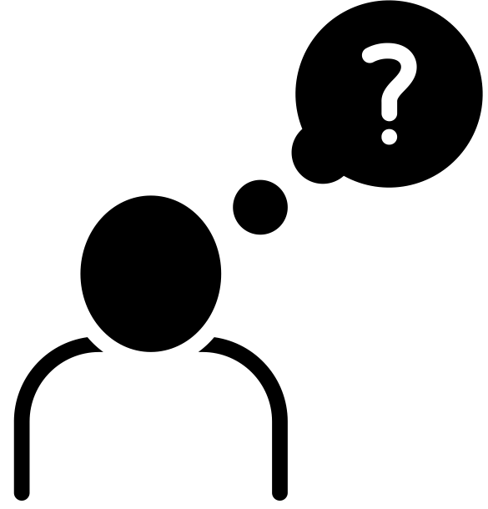
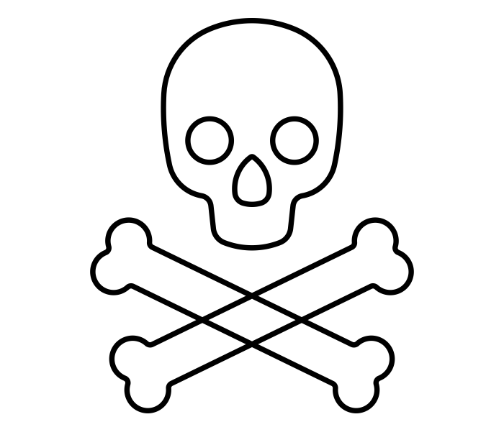
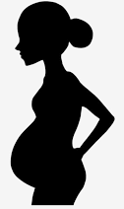
Macbeth
‘When the battle’s lost and won…There to meet with Macbeth’
‘All hail, Macbeth, thou shalt be king hereafter!’ ‘‘Thou shalt get kings, though thou be none:’
’
‘When you durst do it, then you were a man’
‘Sleep no more! Macbeth doth murder sleep’
Macbeth struggles with his conscience and decides not to kill Duncan until Lady Macbeth calls him a coward. Macbeth decides to kill the king.
Macbeth returns from killing Duncan and tells Lady Macbeth he heard a voice telling him he’ll ‘sleep no more’.
The play opens with three witches gathering during a thunder and lightening storm. They plan to meet with Macbeth that evening.
.
The witches prophesise that Macbeth will become King of Scotland.. They tell Banquo that his children will be kings but he will not.
‘’my hands are of your colour’
Act 2
Realising Macbeth has brought the daggers with him, Lady Macbeth returns the daggers to frame the guards.
Act 1
‘brave Macbeth--well he deserves that name’
‘unsex me here and fill me… full of direst cruelty!’
‘A dagger of the mind, a false creation
King Duncan is told that ‘brave Macbeth’ has fought against the rebel forces led by Macdonald and gives Macbeth the title ‘Thane of Cawdor’.
Lady Macbeth reads a letter from her husband and calls on the spirits to make her more like a man so she will be capable of killing Duncan.
Macbeth has a vision of a bloody dagger on his way to kill Duncan.
‘Fly, good Fleance’
‘I fear thou play'dst most foully for't’
Banquo is killed but Fleance manages to escape.
Banquo begins to suspect that Macbeth killed Duncan.
Act 4
Act 3
Plot summary
Macbeth visits the witches and they show him three apparitions warning him to ‘beware Macduff’ and that ‘none of woman born shall harm Macbeth’. They tell Macbeth that he will not be defeated until ‘Great Birnam wood to high Dunsinane hill Shall come against him’ .
‘Most sacrilegious murder’
‘Blood will have blood’
‘O, full of scorpions is my mind’
Macduff discovers Duncan has been murdered. Macbeth and Lady Macbeth pretend to be innocent.
The ghost of Banquo sits at Macbeth’s place at the banquet table. Macbeth is visibly shaken and Lady Macbeth tells the guests to leave.
Lady Macbeth becomes concerned about the state of Macbeth’s mind.
‘Fear not, Macbeth’
‘Macduff was from his mother's womb untimely ripp'd.’
Macbeth is over-confident about the forthcoming battle because of the witches’ prophecies.
Macduff confronts Macbeth on the battlefield and reveals he was born via c-section. Macduff kills Macbeth.
Act 5
The End
‘A show of Eight Kings, the last with a glass in his hand; GHOST OF BANQUO following’’
Macbeth demands to know more and the witches show him an apparition of eight kings following Banquo’s ghost.
‘He has kill'd me, mother’
‘Out, damned spot!’
‘I look'd toward Birnam, and anon, methought, The wood began to move.’
‘’Hail, King of Scotland!’
Lady Macduff and her children are murdered on Macbeth’s orders.
Lady Macbeth begins to sleepwalk re-enacting the murder of Duncan.
Malcolm is hailed as the new King of Scotland
Macbeth is told that his wife is dead and a messenger arrives telling Macbeth that he has saw the wood move.

Slide 3
Task: Annotate the images using the key below:
AO1 – Plot / Quotes
AO2 – Methods / Impact
AO3 – Intent / Context

Slide 4
Key Word Recall
 | Militaristic | Arc | Chain of Being
Bloodlust | Eleventh Century | Tanistry | Holinshed’s Chronicles

Slide 5
More Key Words: What do you understand about them?
Trochaic tetrameter
Soliloquy
Jacobean
Hamartia
Motif
Regicide

Slide 6
Big Idea: Tanistry
In many ways, the Law of Tanistry is at the core of Shakespeare's Macbeth. Though never mentioned in the play, the practice would have been well understood, if perhaps not by the contemporary groundlings, then certainly by the most important person in the audience: James I, who abolished the practice by legal decree early in his reign.

Slide 7
Tanistry: Independent Reading
Macbeth as a text holds true to the historical facts of the monarchy in Scotland. Scotland was both an elective monarchy and a tanistry. An elective monarchy is a monarchy ruled by an elective monarch, in contrast to a hereditary monarchy in which the office is automatically passed down as a family inheritance. The group of nobleman, who could be selected as monarch, would have been small. Tanistry was a Gaelic system for passing on titles and lands. In this system the Tanist would be chosen from a pool to succeed to a title. You could also be named as Tanist by attaining a high rank. Thus Macbeth holds some claim to now being in line to succeed to the throne.
What does monarchy mean?
What kind of monarchy did Scotland have at the time the play was set?
What does elective mean?
What is an elective monarchy?
What does hereditary mean?
What is a hereditary monarchy?
What does Gaelic mean?
How was a successor chosen using a Tanist system?
What makes Macbeth a perfect candidate for being named a Tanist?
Are there any other characters Duncan might consider as his successor? Explain.

Slide 8
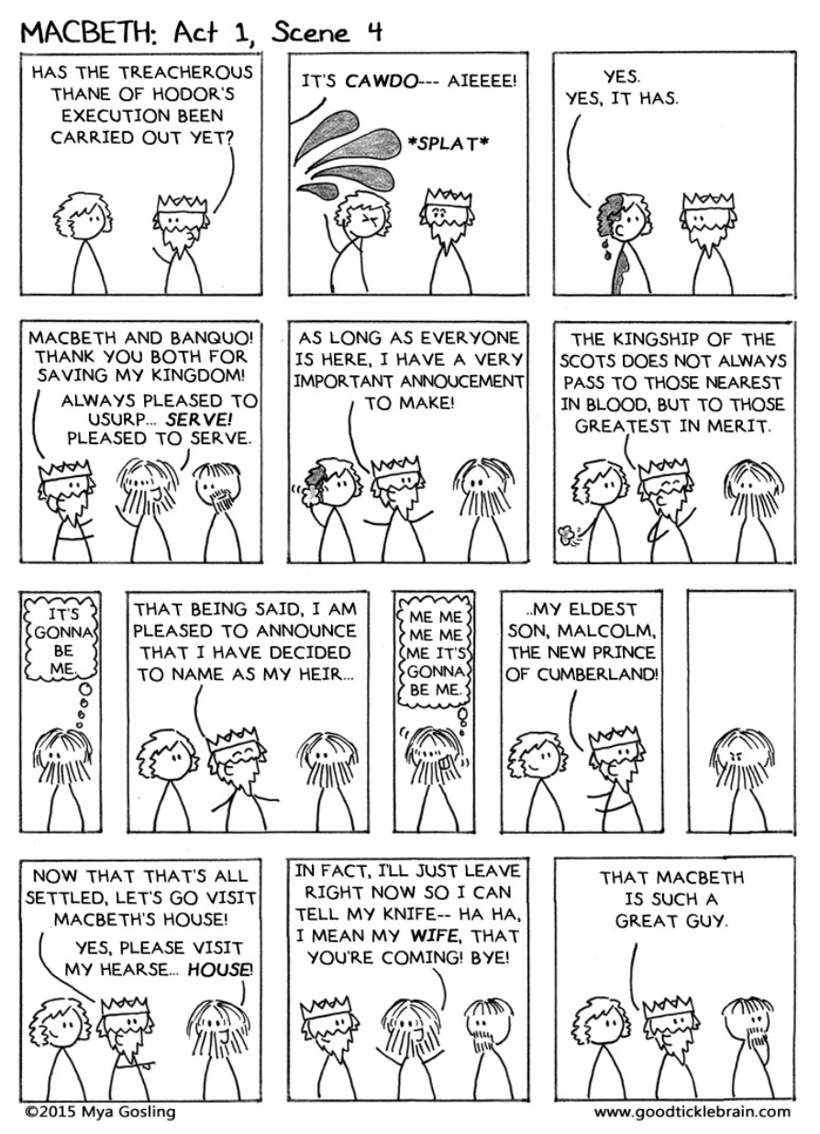
Act 1:4 – A Pivotal Scene
Use the comic strip to summarise what happens in Act 1 Scene 4 (no more than 5 sentences)
Now let us skim the scene → add anything significant you may have missed
Finally, let’s listen to a video summary of the scene → anything else to add?

Slide 9
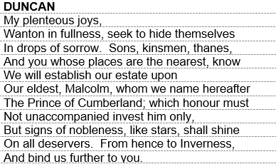
Whom does Duncan elect as Tanist?
Who is next in line to be King?
If the Scottish crown was not hereditary at this time, why does Duncan choose this person as his successor?
It was uncommon for the King to elect the Tanist. Who should have been responsible for this?
Why does no one challenge Duncan’s choice? (consider the Jacobean belief of the time)
Does this make the monarchy elective or hereditary? Explain how you know.
How would this scene have appealed to James I?

Slide 10
‘Big’ Questions
Why does Shakespeare begin the play with the witches/weird sisters?
What is the role, as a dramatic device, of Macbeth’s letter to his wife?
Why does Shakespeare have Macbeth and Banquo respond very differently to the witches’ predictions?
How do Macbeth’s public and private personae differ?

Slide 11
Theme Explosions
Ambition
Kingship
The Supernatural
Violence
Gender
Public versus Private
Guilt

Slide 12
Cause and Effect
 | Macbeth kills Duncan

Slide 13
Plenary
Choose one statement. Write it out. Give three reasons/pieces of evidence as to why you agree with it.
‘Macbeth’ is, at heart, a love story.
Macbeth’s claim to the crown is somewhat justified.
Society must share some of the blame for Macbeth’s bloodlust.

