Slide 1
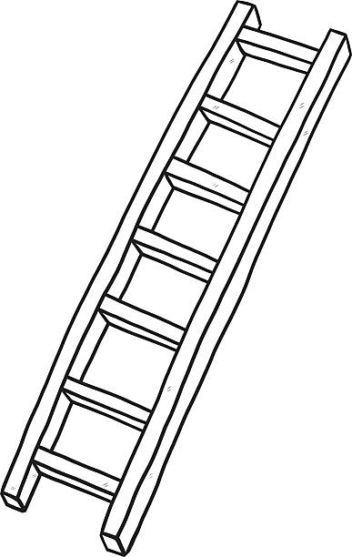
STEP 4 | 40 = 100% | Consistent end punctuation, range of ambitious punctuation, and full range of sentence forms for effect.
 | 39 = 98% | Extensive and ambitious vocabulary.
 | 38 = 95% | Convincing, compelling communication, assuredly matched to PAF.
 | 37 = 93% | Sustained crafting of descriptive devices (perhaps irony, synecdoche etc.).
 | 36 = 90% | Structured and developed; integrated range of complex ideas: motif, etc.
 | 35 = 88% | Varied and inventive structural features (multiple perspectives, etc.).
STEP 3 | 34 = 85% | End punctuation is mostly secure and accurate.
 | 33 = 83% | Range of punctuation used (including internal) mostly successfully.
 | 32 = 80% | A variety of sentence forms used for effect.
 | 31 = 78% | Mostly used Standard English appropriately.
 | 30 = 75% | Generally accurate spelling (complex and irregular spellings).
 | 29 = 73% | Increasing sophisticated vocabulary and phrasing.
 | 28 = 70% | Consistently clear and effective communication.
 | 27 = 68% | Tone, style and register matched to purpose, format, audience.
 | 26 = 65% | Range of appropriate descriptive devices (eg: extended metaphor/simile).
 | 25 = 63% | Detailed, connected ideas and engaging style.
 | 24 = 60% | Effective use of structural features (eg: short paragraph/countdowns).
STEP 2 | 23 = 58% | End punctuation is usually secure.
 | 22 = 55% | Some control of a range of punctuation.
 | 21 = 53% | Attempts a variety of sentence forms.
 | 20 = 50% | Some Standard English; some subject-verb agreement.
 | 19 = 48% | Some accurate spelling of more complex words.
 | 18 = 45% | Varied vocabulary.
 | 17 = 43% | Communication is mostly successful.
 | 16 = 40% | Sustained attempt to match purpose, format, audience.
 | 15 = 38% | Some descriptive devices – perhaps, similes/personification/metaphors.
 | 14 = 35% | Increased range of linked and relevant ideas.
 | 13 = 33% | Some use of structural features (discourse markers etc.)
STEP 1 | 12 = 30% | Some end punctuation.
 | 11 = 28% | Some conscious punctuation.
 | 10 = 25% | Simple range of sentences.
 | 9 = 23% | Occasional Standard English; limited subject-verb agreement.
 | 8 = 20% | Accurate basic spelling.
 | 7 = 18% | Simple vocabulary.
 | 6 = 15% | Simple communication of ideas.
 | 5 = 13% | Basic awareness of purpose, format, and audience.
 | 4 = 10% | Simple descriptive device (onomatopoeia, for example).
 | 3: = 8% | Some linked ideas.
 | 2 = 5% | Random paragraphs.
 | 1 = 3% | Some evidence of structure/organisation.
Creative Writing: Ladder of Success

